Slide 1
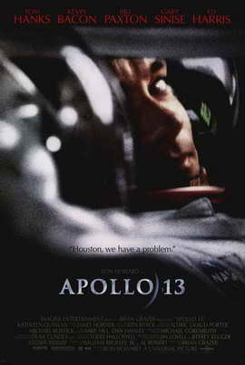
Apollo 13 (1995)
Produced by: Brian Grazer
Directed by: Ron Howard
Director of Photography: Dean Cundey
Music by: James Horner
Screenwriters: William Broyles, Jr. &
Al Reinart
Tom Hanks: Jim Lovell
Bill Paxton: Fred Haise
Kevin Bacon: Jack Swigert
Gary Sinise: Ken Mattingly
Ed Harris: Gene Kranz
Kathleen Quinlan: Marilyn Lovell
Based on the book Lost Moon (later re-issued as Apollo 13) by Jeffrey Kluger and Jim Lovell
Academy Awards:
WON: Sound, Editing
NOMINATED: Picture, Supporting Actor (EH), Supporting Actress (KQ), Adapted Screenplay, Music, Art Direction, Visual Effects

Slide 2
APOLLO 13 LOG WORK:
As you watch the film, look for the scene you adapted. When you find it, make some notes about the techniques that were used and the choices that were made, specifically thinking about whether they are similar to or different from the adaptation decisions you made. You will need to write about this later.
Roger Ebert called this film “riveting.” Janet Maslin of The New York Times called this film “absolutely thrilling.” The American Film Institute has ranked Apollo 13 the #12 most inspirational American film of all time. The narrative is certainly a powerful part of the NASA story, but since we know that everything works out in the end going into the film, think about how Ron Howard constructed a film that still gripped the audience into the momentum of the story. As you screen the film, make a list of the specific FILM techniques, stylistic decisions, cinematic choices, etc. (not the story itself) that worked to enhance the “riveting,” “thrilling” quality of the film.

Slide 3
*Put in a box (about 10 lines) for notes on YOUR scene
*Then, set up your viewing chart:
Technique/stylistic element and example | How it makes that scene “thrilling” or “riveting”

Slide 4
APOLLO 13 LOG WORK-You must answer #1. Then, select either #2 or #3 to address.
1. Consider your adaptation; did you like your version or Ron Howard’s
version better? Why? Discuss your vs. his filmic choices.
2. Jim Lovell has said that he wrote the book Lost Moon because he thought the story contained important lessons about initiative, imagination, teamwork, leadership, perseverance, and American ingenuity. Pick one of those thematic ideas and connect two “absolutely thrilling”/”riveting” film techniques that help to develop the theme. In other words, how did Ron Howard’s approach to a well-known story make a theme come alive and be interesting/ engaging?
While most see this film as an inspirational epic tale, viewers do have criticisms. Select one critique and discuss it. Do you agree or disagree with the criticism? Be sure to reference specifics from the film.
music as bully (soundtrack too overwhelming, heavy-handed, manipulative)
don’t get to know the characters as complex humans/don’t get to know who the characters are; they are one-dimensional
too sentimental/melodramatic/over-the-top.
Notes:
Put critiques on the whiteboard since not enough room on slide:
-music as bully (soundtrack too overwhelming, heavy-handed, manipulative)
-don’t get to know the characters as complex humans/don’t get to know who the characters are - one-dimensional characterizations (astronaut as honorable dullard)
-too sentimental/melodramatic/over-the-top

